Slide 1



Retail Sales Dashboard
View in Power BI
Last data refresh:
4/5/2020 10:49:54 AM Eastern Standard Time
Downloaded at:
4/30/2020 1:05:10 PM Eastern Standard Time

Slide 2
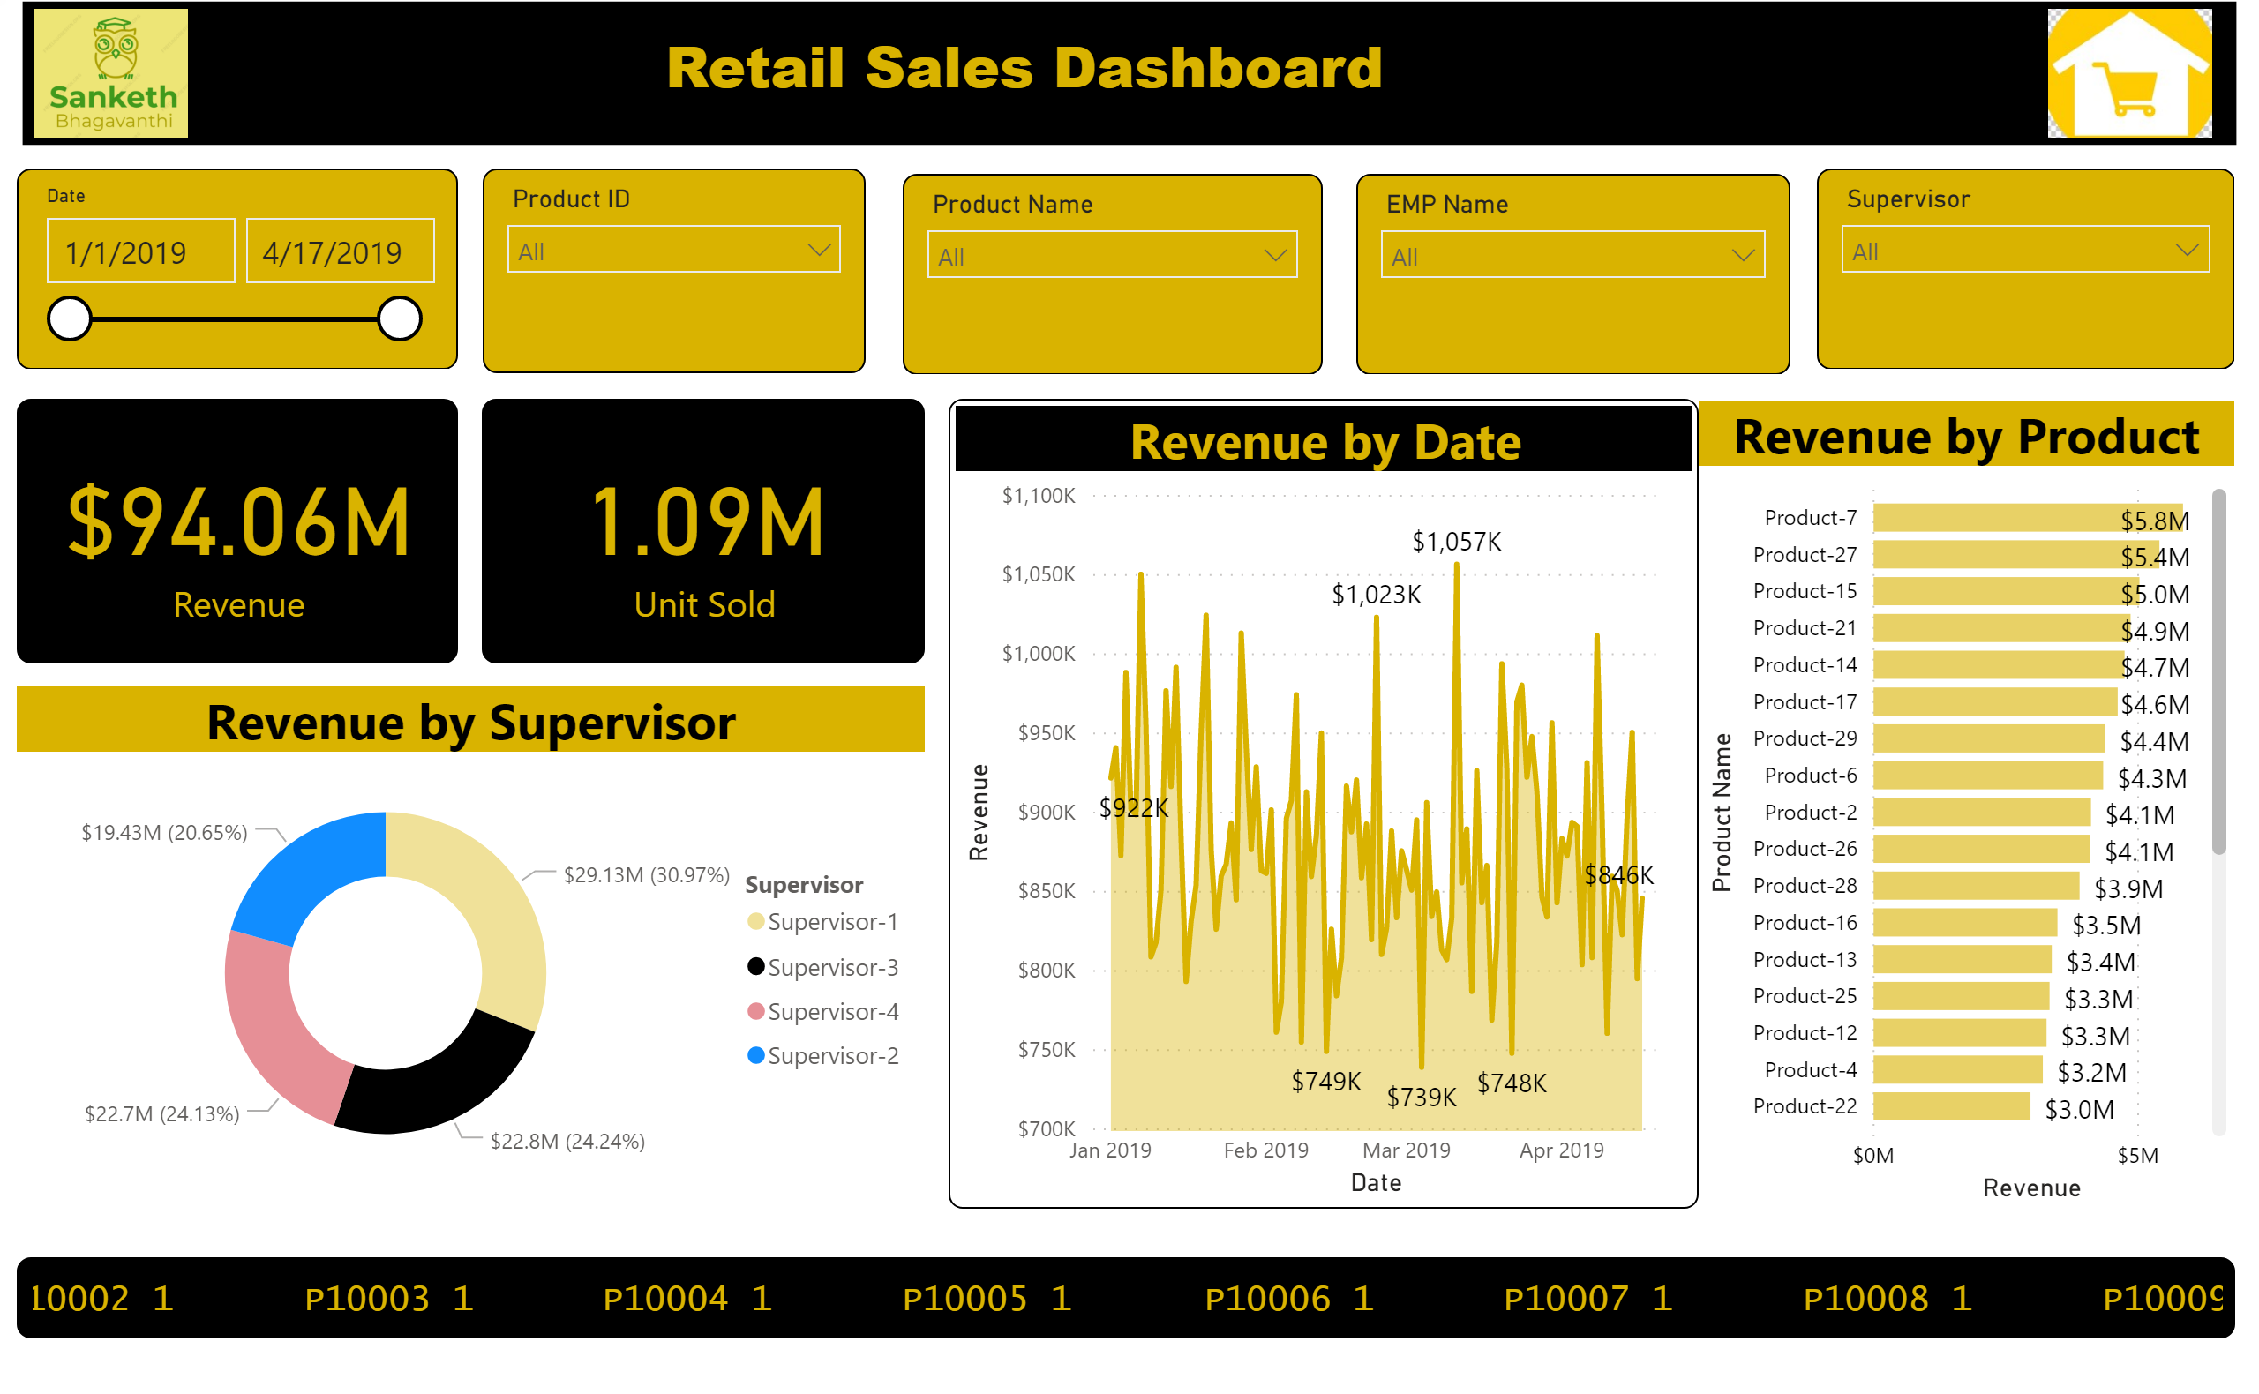

Slide 3
